Slide 1

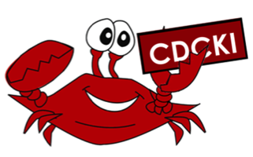

Life on the District Board
Capital District Circle K International
Membership Development & Education Committee
February 2015

Slide 2
DCON is almost here!
District Convention is right around the corner.
During the convention, we will be electing new officers to serve on the 2015-2016 Capital District Board.
That means we need candidates to step up and run for the awesome leadership positions!
But maybe you want to know a little bit more about what it means to be a district board member…

Slide 3
Open Positions
Governor
Secretary-Treasurer
Editor
8 Lieutenant Governors (1 per division)

Slide 4
Responsibilities
As a member of the district board, all positions are responsible for:
Staying in constant contact with members and club officers throughout the district to keep them updated about events and procedures.
Planning, running, and attending district events like FMR, DCON, SOTC, and DLSSP.
Attending District Kiwanis and Key Club events as able.
Making decisions will ALL members of the district in mind.
Attending ALL board meetings (usually 6 each service year).

Slide 5
Perks
Interacting with CKI members from across the district (as well as beyond our district).
Meeting and making connections with members of Kiwanis and Key Club from within the Capital District.
Building an amazing support system among the many members of the district board.
Making a difference in an international organization-a difference you can see reflected throughout the district and in your own club.

Slide 6

At the end of the day…
Serving on the district board means getting to “Live to Serve.” and “Love to Serve.” with individuals who embody that motto as much as you do!

Slide 7
Feeling Called To Serve?
Do these responsibilities and perks sound like an amazing opportunity to you? They definitely are!
Think you can hack it as a district officer? I bet you can!
Consider running for district office at DCON!

Slide 8
Contact your Lt. Governor if you are interested in running for a position.
They can make sure you have all the information you need to campaign and run for office successfully!

